Slide 1

An Overview of Self-Driving Car
Md Yasin Arafat

Slide 2
Content
Story of Self-Driving Car
Taxonomy of Self-Driving Car
Research Projects
How Self-Driving Car see
Path Planning
Method of Mapping
Road Safety and Operation
Question and answer

Slide 3
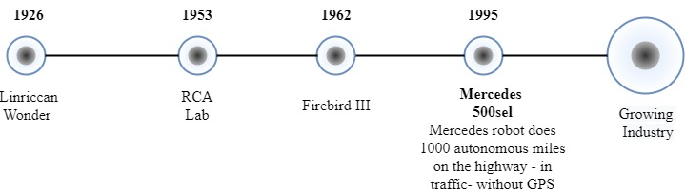
Self-Driving Car
Driven through digital technologis without human intervention.
Timeline of the industry

Slide 4
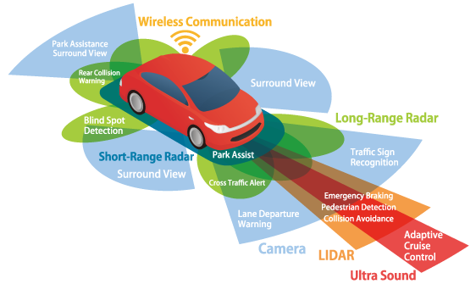
Common View of Self-Driving Car

Slide 5
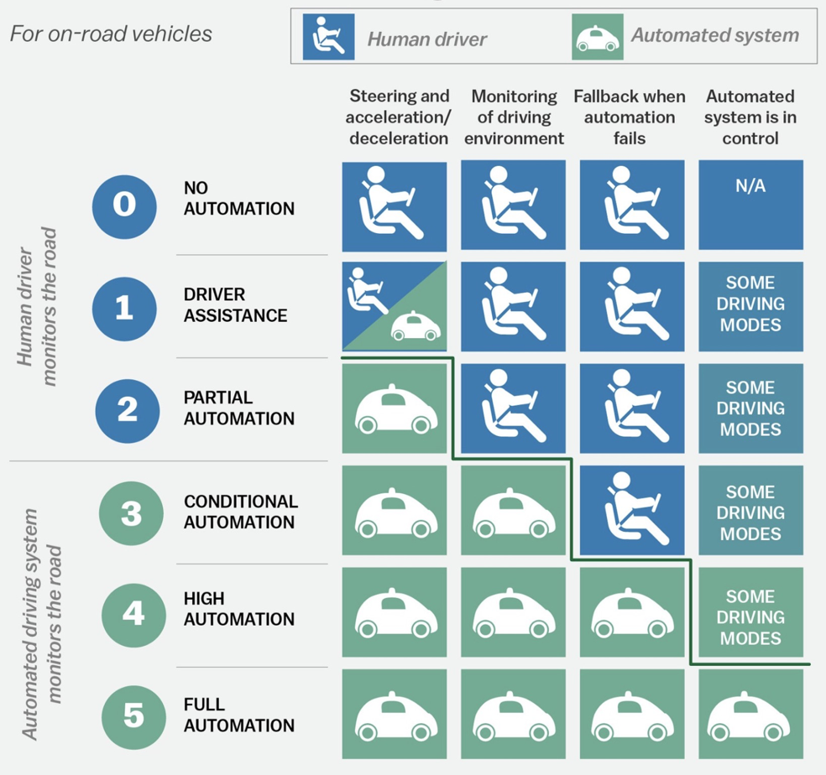
Taxonomy of Self-Driving Car

Slide 6
Ongoing Projects
Google Driver-Less Car
BMW Connected Drive
Mercedes S500 Intelligent Drive
Toyota/Lexus Research Car
VisLab BRAiVE
BOSS Car

Slide 7
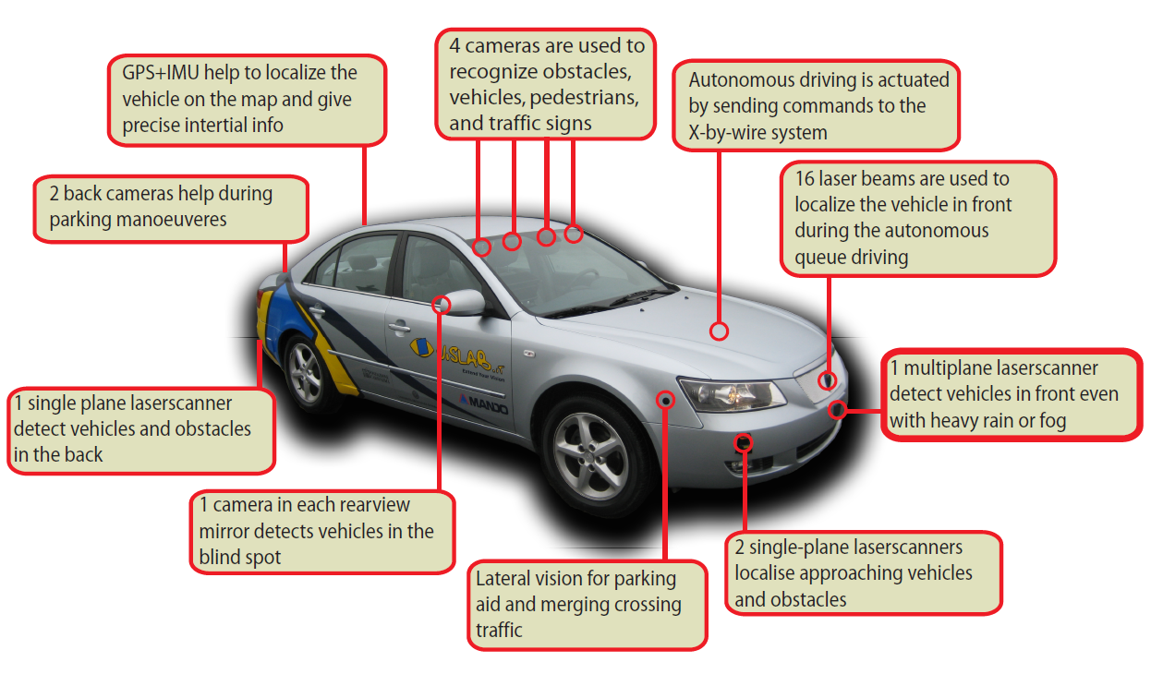
VisLab BRAiVE

Slide 8
Typically used sensors
Camera
LIDAR
RADAR
SONAR/Ultrasonic
Most significant matrics for sensors
Range/Dynamic range
Field-of-view
Resolution
Computing Hardware
GPS
IMU
Wheel odometry sensors

Slide 9
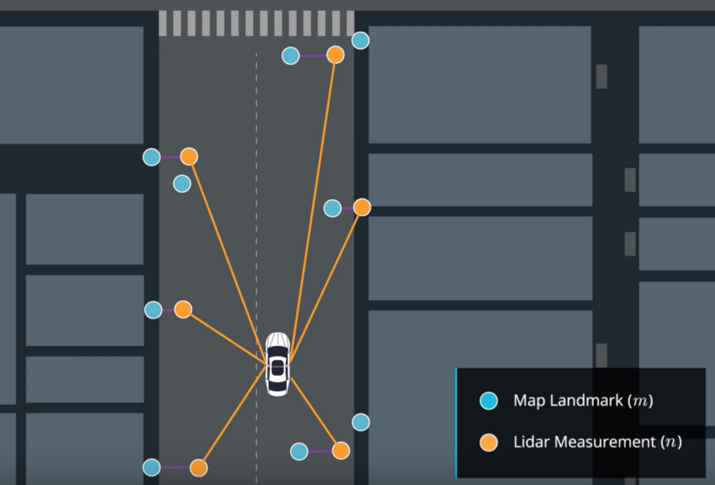
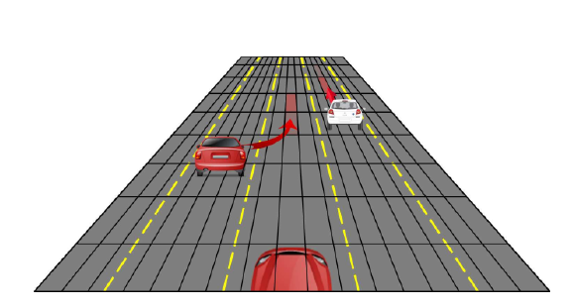
Maps used in Self-Driving Car
Detailed road map
Localisation Maps
Occupancy grid map

Slide 10
Road Safety and Operation
NHTSA focuses on:
live savings
prevent injuries
minimize crashes
Through
awareness
education
research
safety protocols
enforcement of activity
N.B: It approached a non-regulatory offer to automated driving vehicle safety comprising 12 safety elemetns.

Slide 11
Conclusion
Active resarch field both in academia and industry level
Correlation among legislation team, manufacturer, insurer, and consumer is required
Both EU and American market have been working actively to put this industry in light

Slide 12
References
https://medium.com/@BabakShah/levels-of-automation-for-self-driving-cars-d410a4f679b7
https://www.gmheritagecenter.com/gm-vehicle-collection/1958_Firebird_III.html

Slide 13
Thank you for your attention.

